Slide 1
Lecture 6
Sept. 11th ,2019
Lab report 1 due Thursday, Sept 12th at the beginning of your lab.
Lab 2 is uploaded. Please read and be ready!
Elephants….

Slide 2
Where were we?
  Cell cycle regulation---give some details.
  Use the driving of a car analogy.
  Why is regulation even necessary?
  Name some proteins that participate. Give some specific details about them.
  What happens when it breaks down?
  Describe the different types of “cancer genes” and expected mutations associated with cancer.

Slide 3
Where were we?
  How do chromosomes “condense”?
  Why do chromosomes “condense”?

Slide 4
Chromosomes are DNA associated with proteins
  DNA binds and wraps around complexes of histone proteins to form the basic level of DNA structure in cells---the nucleosome.
  Nucleosomes associate with each other and with other proteins as the chromosome condenses.
  DNA and its associated proteins is referred to chromatin (sometimes the thinnest form of chromosomes, in interphase, is called chromatin)

Slide 5
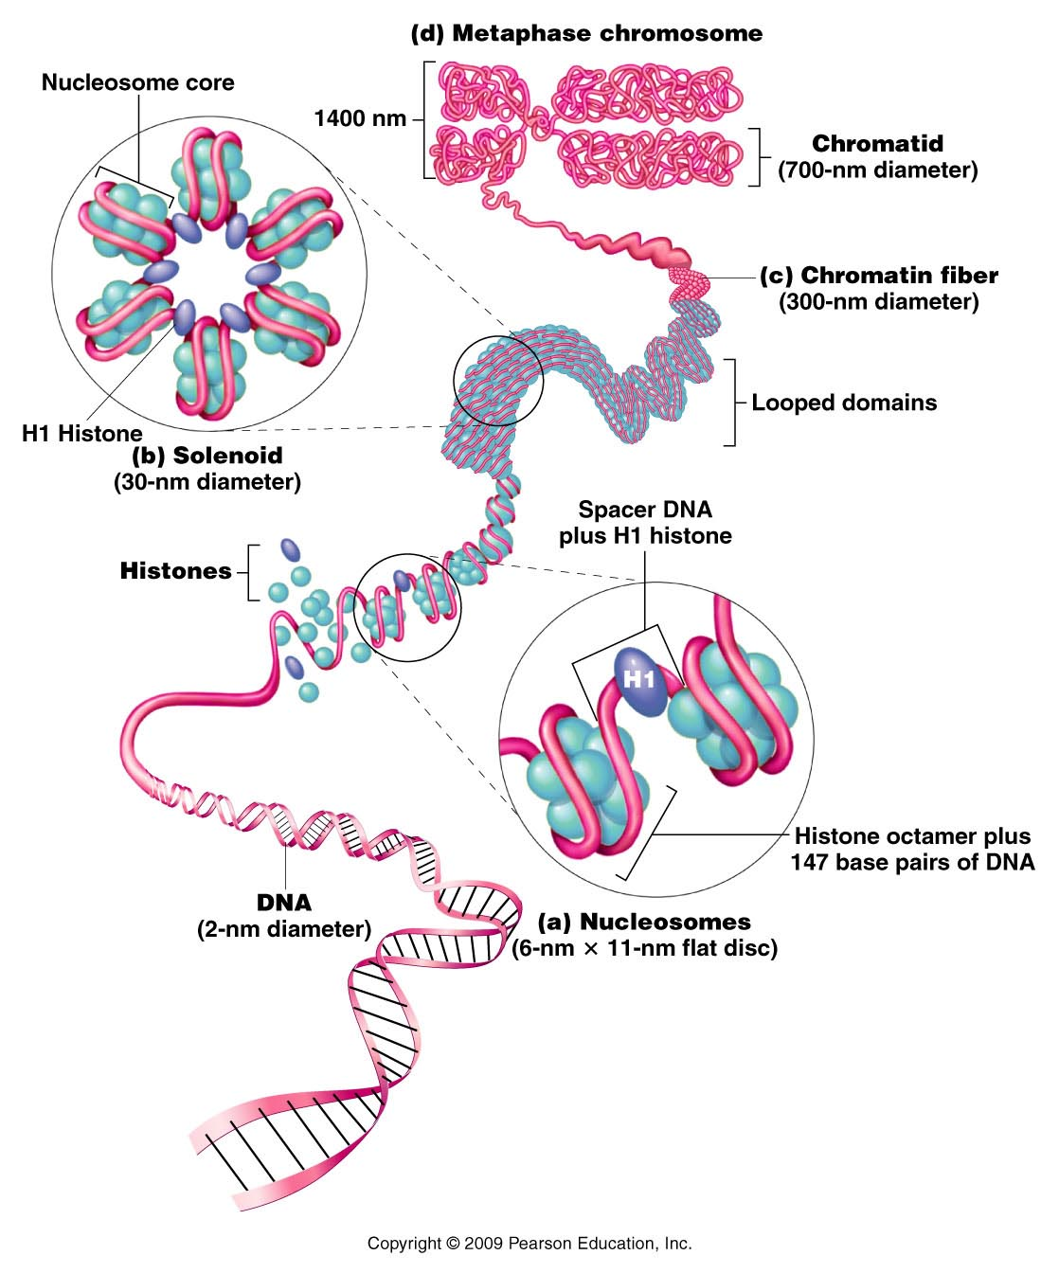
Text ections 12.4 and 12.5 are useful for more detail.
Figure 12.9
Notes:
Figure 12-9 General model of the association of histones and DNA in the nucleosome, illustrating the way in which the chromatin fiber may be coiled into a more condensed structure, ultimately producing a mitotic chromosome.

Slide 6
Variation in condensation
Even in fully condensed chromosomes, regions will be coiled more or less tightly than other regions.
  DNA takes up stains differently depending on its level of condensation. This gives rise to the unique banding pattern that allows identification of individual chromosomes.

Slide 7
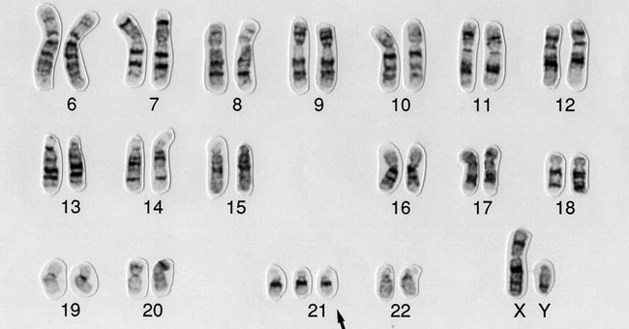

Slide 8
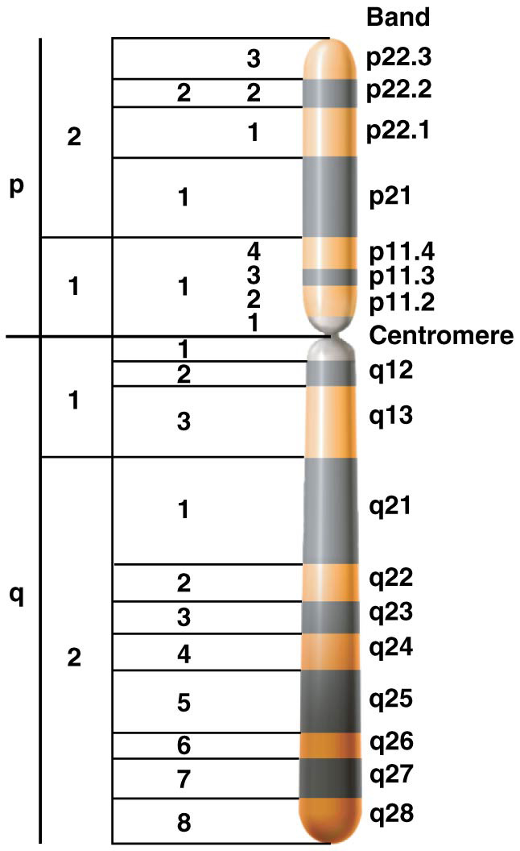
Figure 12–13 The regions of the human X chromosome distinguished by its banding pattern.

Slide 9
Likewise…in interphase chromosomes (least condensed state) the chromosome varies in level of condensation:
  Generally speaking, the more tightly coiled, the less accessible the DNA is for gene expression.
  Modification of DNA and of histone proteins affects how coiled/accessible the DNA is.

Slide 10
The study of the level of condensation/compaction of DNA is one aspect of a very important field of genetics called epigenetics.
Epigenetics deals with features and alterations of DNA that have nothing to do with the ATGC sequence.

Slide 11
Chemical modifications of DNA change the level of condensation, locally, in specific regions of the chromosome.
For example, addition of CH3 groups, can make the DNA condense more.

Slide 13
Generally the more condensed the DNA, the less likely genes are able to be expressed in that region.
Gene expression=transcription
The genes are physically less accessible for transcription

Slide 14
Begin meiosis
Start with the same concept of a diploid (2N)organism (having 2 sets of chromosomes, one from each parent)
Purpose of meiosis?
  1. Mechanism for producing haploid sex cells/gametes 2N N
  2. Mechanism for introducing genetic variation
  ---meiosis distributes maternal and paternal homologs randomly
  ---meiosis allows exchange of DNA between maternal and paternal homologs.

Slide 15
Meiosis reduces the chromosome number from 2N to N
How?
  Cell (germ cell/pre-sex cell) prepares for cell division by replicating DNA
  Cell undergoes 2 successive divisions
    Meiosis I (includes prophase, metaphase, anaphase, telophase)
    Meiosis II (includes prophase, metaphase, anaphase, telophase)
    **Product of meiosis is 4 haploid cells

Slide 16
The 2 cell divisions are somewhat similar to mitotic division, with 4 distinct subphases.
Prophase I, Metaphase I, Anaphase I
Telophase I
Prophase II, Metaphase II, Anaphase II, Telophase II

Slide 17
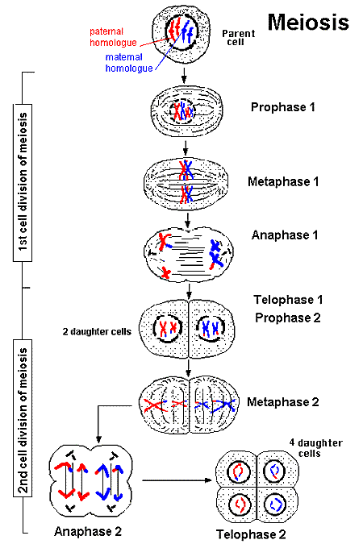

Slide 18
Let’s sketch an over view.
Keep in mind meiosis occurs ONLY in germ cells/cells destined to become gametes
In humans male gametes (sperm) form from meiosis in the cell called a spermatogonium; female gametes (egg or ovum) form from meiosis in the cell called an oogonium.

Slide 19
One of the primary differences between mitosis and meiosis is the behavior of homologous chromosomes.
Mitosis---maternal and paternal copies of each chromosome align at the cell equator independently.
Meiosis--maternal and paternal copies of each chromosome align at the cell equator side by side—in homologous pairs.

Slide 20
The events leading up to pairing of homologs (and eventual exchange of DNA between homologs) occurs in Prophase I
Prophase I can be divided into its own subphases—Leptotene, Zygotene, Pachetene, Diplotene, and Diakinesis.

Slide 21
Prophase I
http://www.macroevolution.net/prophase-details.html#.UuZ7MKV6gUs

Slide 22
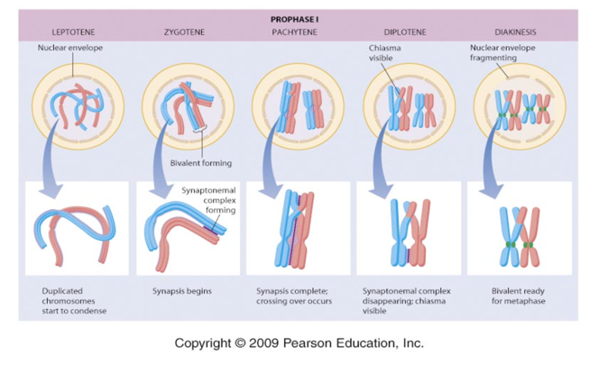

Slide 23
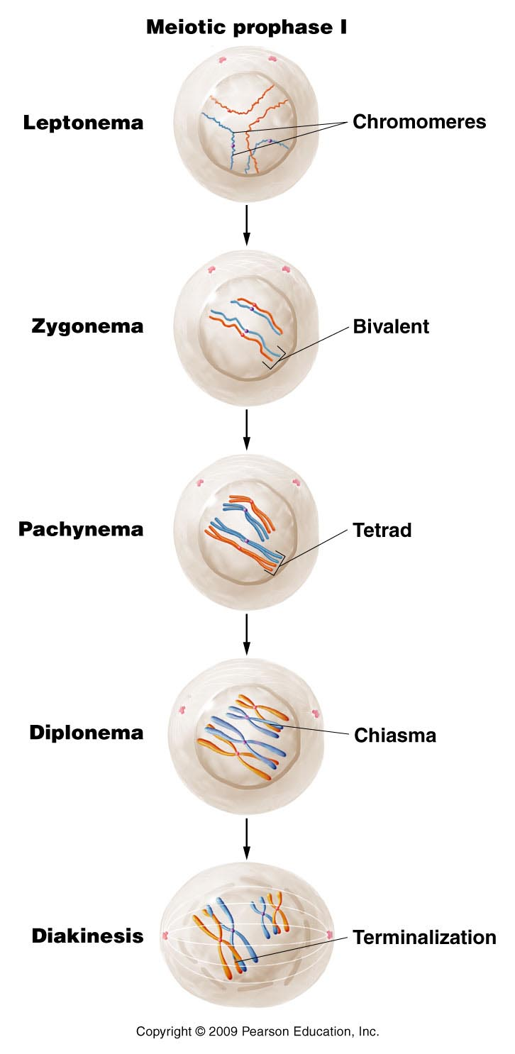
Use lab handouts and textbook for details on what occurs in each subphase of prophase I.
Figure 2.9
Notes:
Figure 2-9 The substages of meiotic prophase I for the chromosomes depicted in Figure 2–8.

Slide 24
Review Meiosis Animation
http://www.sumanasinc.com/webcontent/animations/content/meiosis.html

Slide 25
Try it!
Practice using a mosquito spermatogonium!
2N=6
N=3

Slide 26
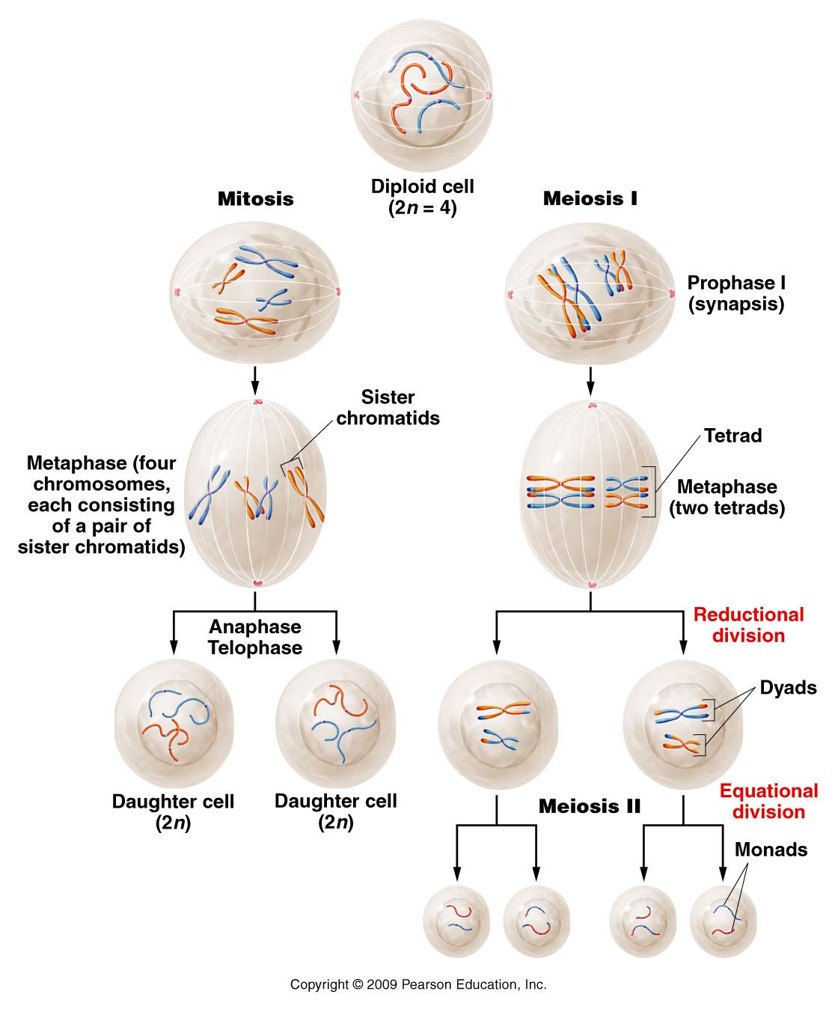
Compare Mitosis and Meiosis
Figure 2.8
Notes:
Figure 2-8 Overview of the major events and outcomes of mitosis and meiosis. As in Figure 2–7, two pairs of homologous chromosomes are followed.

Slide 27
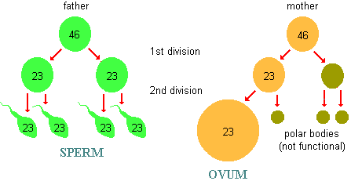
Some differences in male and female gametogenesis (see handouts given in lab)
2N
2N
N N
N N

Slide 28
More differences…
In some animals, female gametogenesis is also discontinuous. Human females go through meiosis 1 just before ovulation and complete meiosis after fertilization!

Slide 29
Meiosis creates gametes with genetic variability
How?—We assume that each person inherited different alleles (different forms of one gene) from their parents for at least some of their genes. In the process of meiosis 2 mechanisms shuffle those alleles into new gametes.
  1. Random alignment of homologs---independent assortment, creates unique combinations of maternal and paternal chromosome in each gamete.
  2. Physical exchange of DNA between maternal and paternal homologs (crossing over with non-sister chromatids) creates entirely new combinations of alleles on each chromosome.

Slide 30
How much variation?
Each pair of homologs can align in 2 ways at the metaphase plate in meiosis I.
Chromosome 1
Chromosome 2
n=2
2n=4
m
p
Number of unique combinations of chromosomes = 4

Slide 31
Basic concept of probability
Number of combinations when 2 possibilities exist for each individual item = 2^{n}
(Coins represent 2-possibility situations)
For n=3 chromosomes, gametes can have 2³ =8 unique combinations of chromosomes

Slide 32
How many unique combinations of maternal and paternal chromosomes can occur in human egg/ova and sperm? n=23
2²³ = 8, 388, 608 combinations in gametes (gametic combinations)!!
Translation? The eggs and sperm you make, combine your mom’s and your dad’s homologous chromosomes in over 8 million combinations.

Slide 33
How may different types of zygotes can be formed when human sperm and ova fuse?
2²³ (sperm) X 2²³(ova) = 2⁴⁶
(gametic combinations) (gametic combinations)
~ 7 X 10¹³ zygotic combinations!

Slide 34
When the same 2 partners have offspring they start out with the same chromosomes to contribute to all their offspring---but the chromosome combinations exceed by far the number of offspring they will produce
Can siblings look quite different? Now it makes sense!

Slide 35
Crossing over creates more variation
Recall that the pairing of homologs during prophase I facilitates the exchange of portions of each homolog.
So the chromosomes you receive from your parents are combined in unique ways before they are distributed to your gametes.

Slide 36
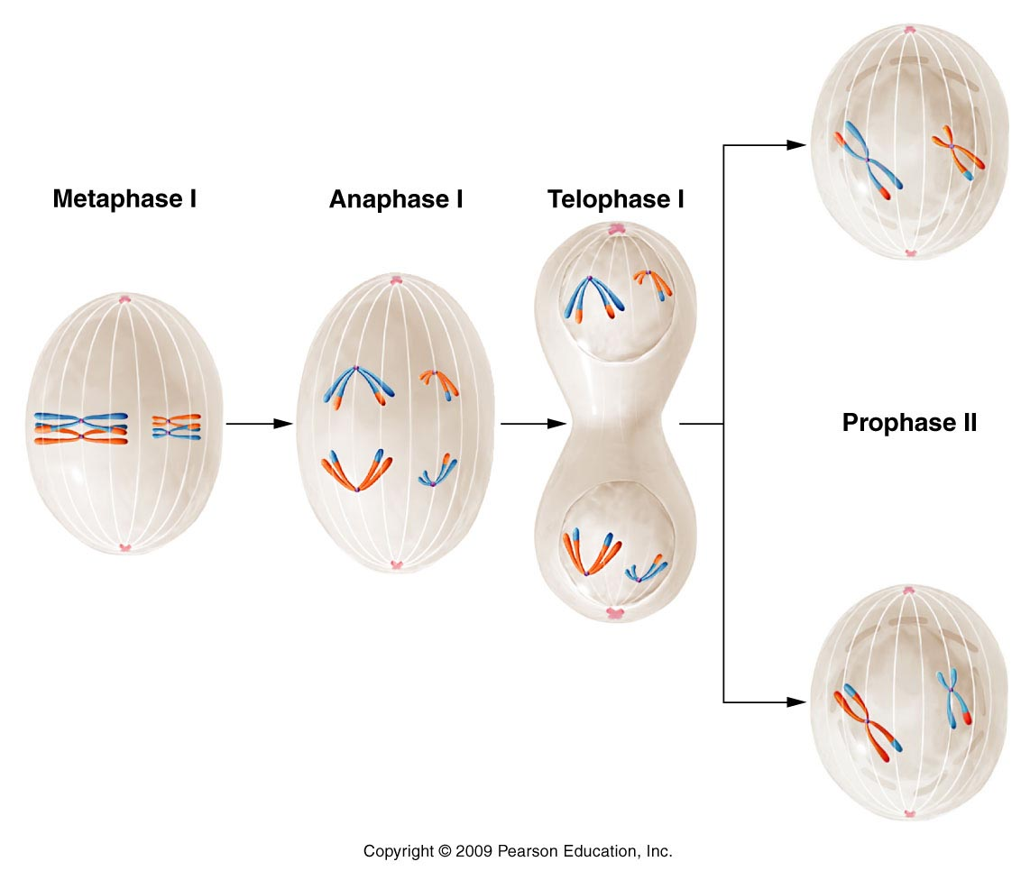
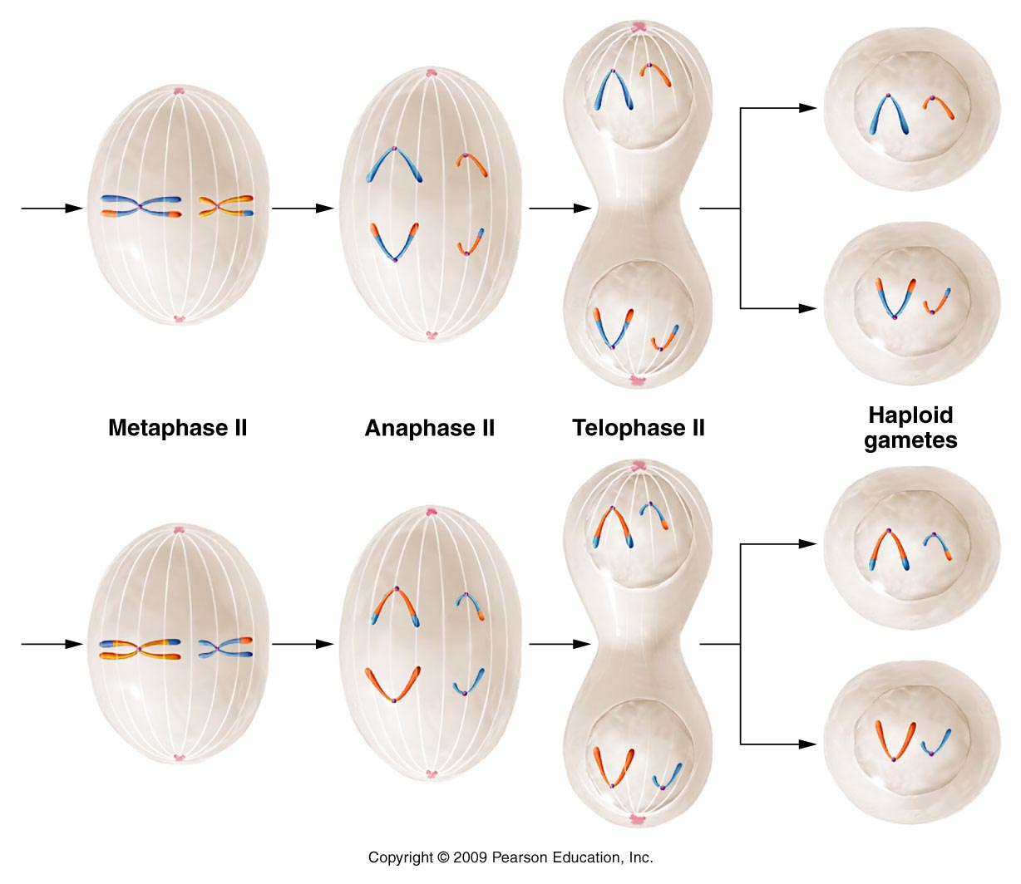
The chromosomes in gametes are mixtures of the homologous pairs in somatic cells.
Figure 2.10
Notes:
36
Figure 2-10 The major events in meiosis in an animal with a diploid number of 4, beginning with metaphase I. Note that the combination of chromosomes in the cells produced following telophase II is dependent on the random alignment of each tetrad and dyad on the equatorial plate during metaphase I and metaphase II. Several other combinations, which are not shown, can also be formed. The events depicted here are described in the text.

Slide 37
You should be convinced at this point that the process of meiosis ensures that offspring will have unique combinations of alleles.
Why is this important?

Slide 38
Genetic variation provides the opportunity for survival of some members of the species when challenged by environmental stresses.
Asexually reproducing organisms (like bacteria) do not have this advantage. Each generation is a genetic clone of the last.
  (there are other ways they can acquire some genetic variability)

